Slide 1
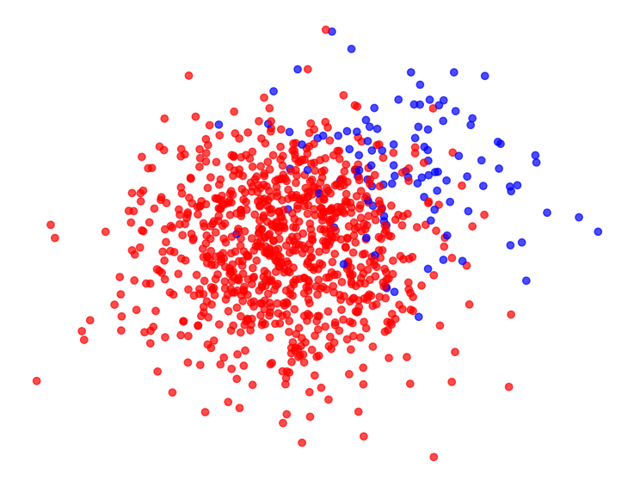
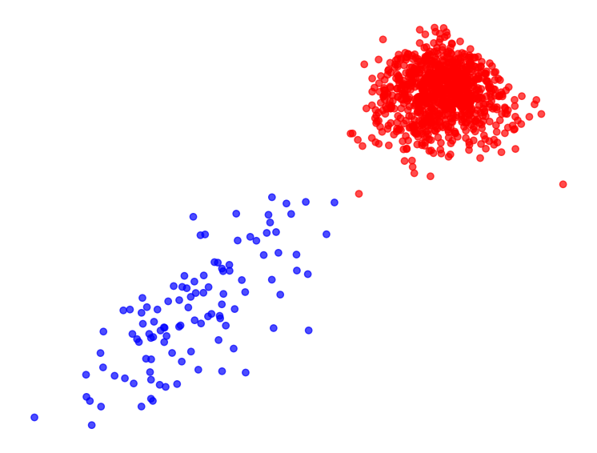
Exploring good transformations of edge weights for spectral clustering
Professor: Patrick Thiran
Assistant: Daichi Kuroda Maximilien Dreveton
Student: Nicolas Gonzalez
Notes:
Good morning
I’m Nicolas, and I’m here to present my master semester project

Slide 2
Table of contents
Introduction
Theoretical background
WSBM
Spectral Clustering
Weight Transformation
Separability Measure
Experimentation
Experimental Setup
Results
Preliminary observations
What’s next
INDY
Notes:
My presentation is structured as follows

Slide 3
Introduction
In the context of spectral clustering, we aim to identify edge weight transformations that most effectively improve community separation in the embedded space.
INDY
Notes:
Just briefly, across all the project graphs being considered are undirected simple and weighted

Slide 4

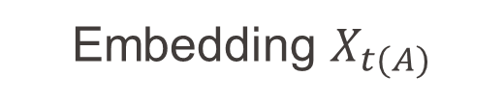

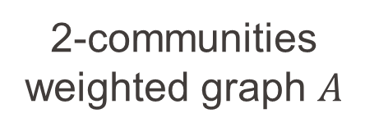
Introduction
2-communities weighted graph $A$
Weight transform $A↦t(A)$
Embedding $X_{A}$
Embedding $X_{t(A)}$
INDY
Notes:
Just briefly, across all the project graphs being considered are undirected simple and weighted

Slide 5
Theoretical Background
INDY
Notes:
Just briefly, across all the project graphs being considered are undirected simple and weighted

Slide 6
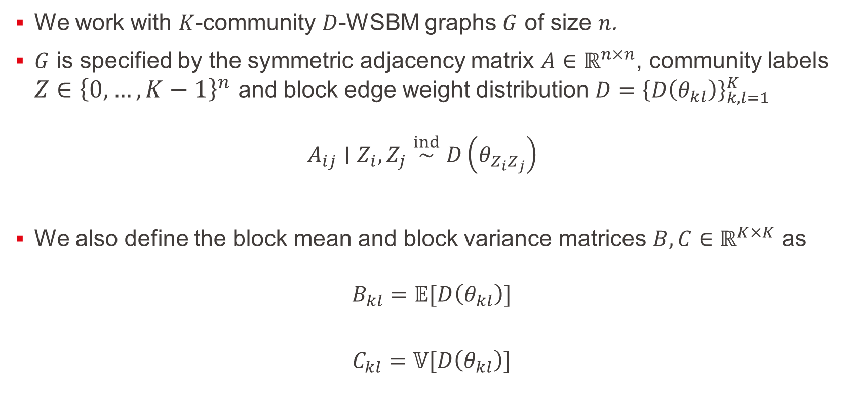
Weighted Stochastic Block Model
We work with $K$-community $D$-WSBM graphs $G$ of size $n$.
$G$ is specified by the symmetric adjacency matrix $A∈ℝ^{n×n}$, community labels $Z∈{\left\{0, …, K−1\right\}}^{n}$ and block edge weight distribution ${D=\left\{D\left(θ_{kl}\right)\right\}}_{k,l=1}^{K}$ $A_{ij}∣Z_{i},Z_{j}\overset{ind}{∼}D\left(θ_{Z_{i}Z_{j}}\right)$
We also define the block mean and block variance matrices $B,C∈ℝ^{K×K}$ as
$$B_{kl}=𝔼[D\left(θ_{kl}\right)]$$
$$C_{kl}=𝕍[D\left(θ_{kl}\right)]$$
INDY
Notes:
Just briefly, across all the project graphs being considered are undirected simple and weighted

Slide 7
What does it look like?
INDY
Notes:
Just briefly, across all the project graphs being considered are undirected simple and weighted

Slide 8
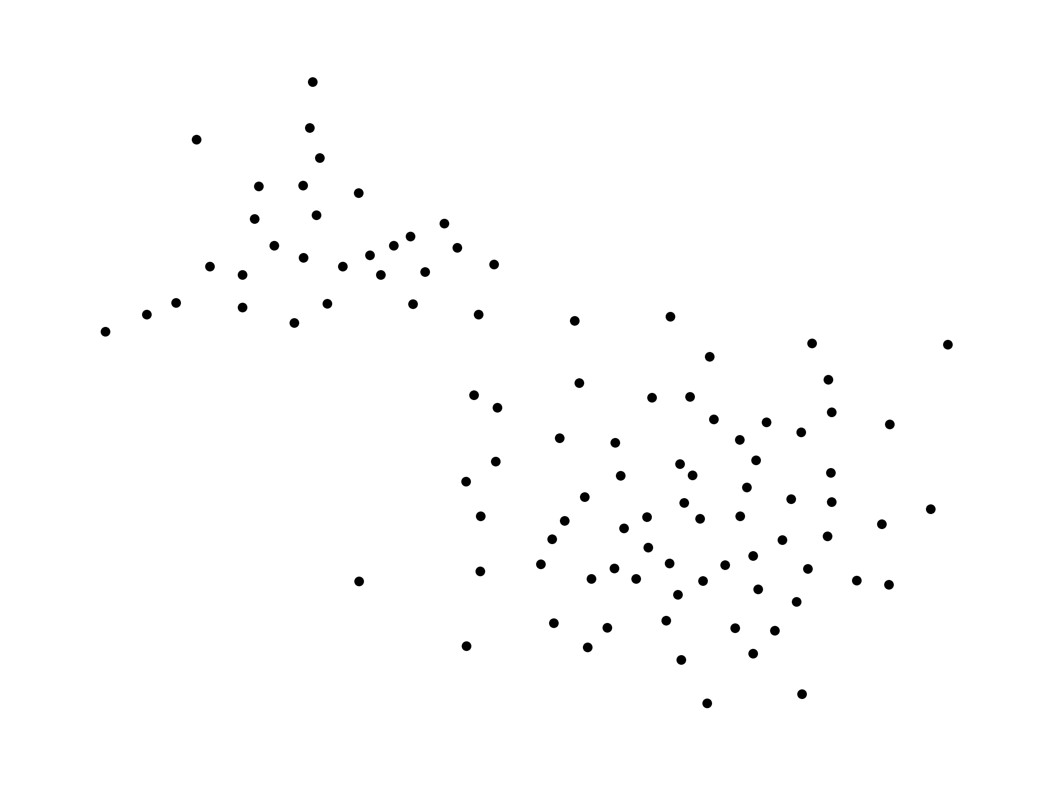
Weighted Stochastic Block Model
INDY
Notes:
Just briefly, across all the project graphs being considered are undirected simple and weighted

Slide 9
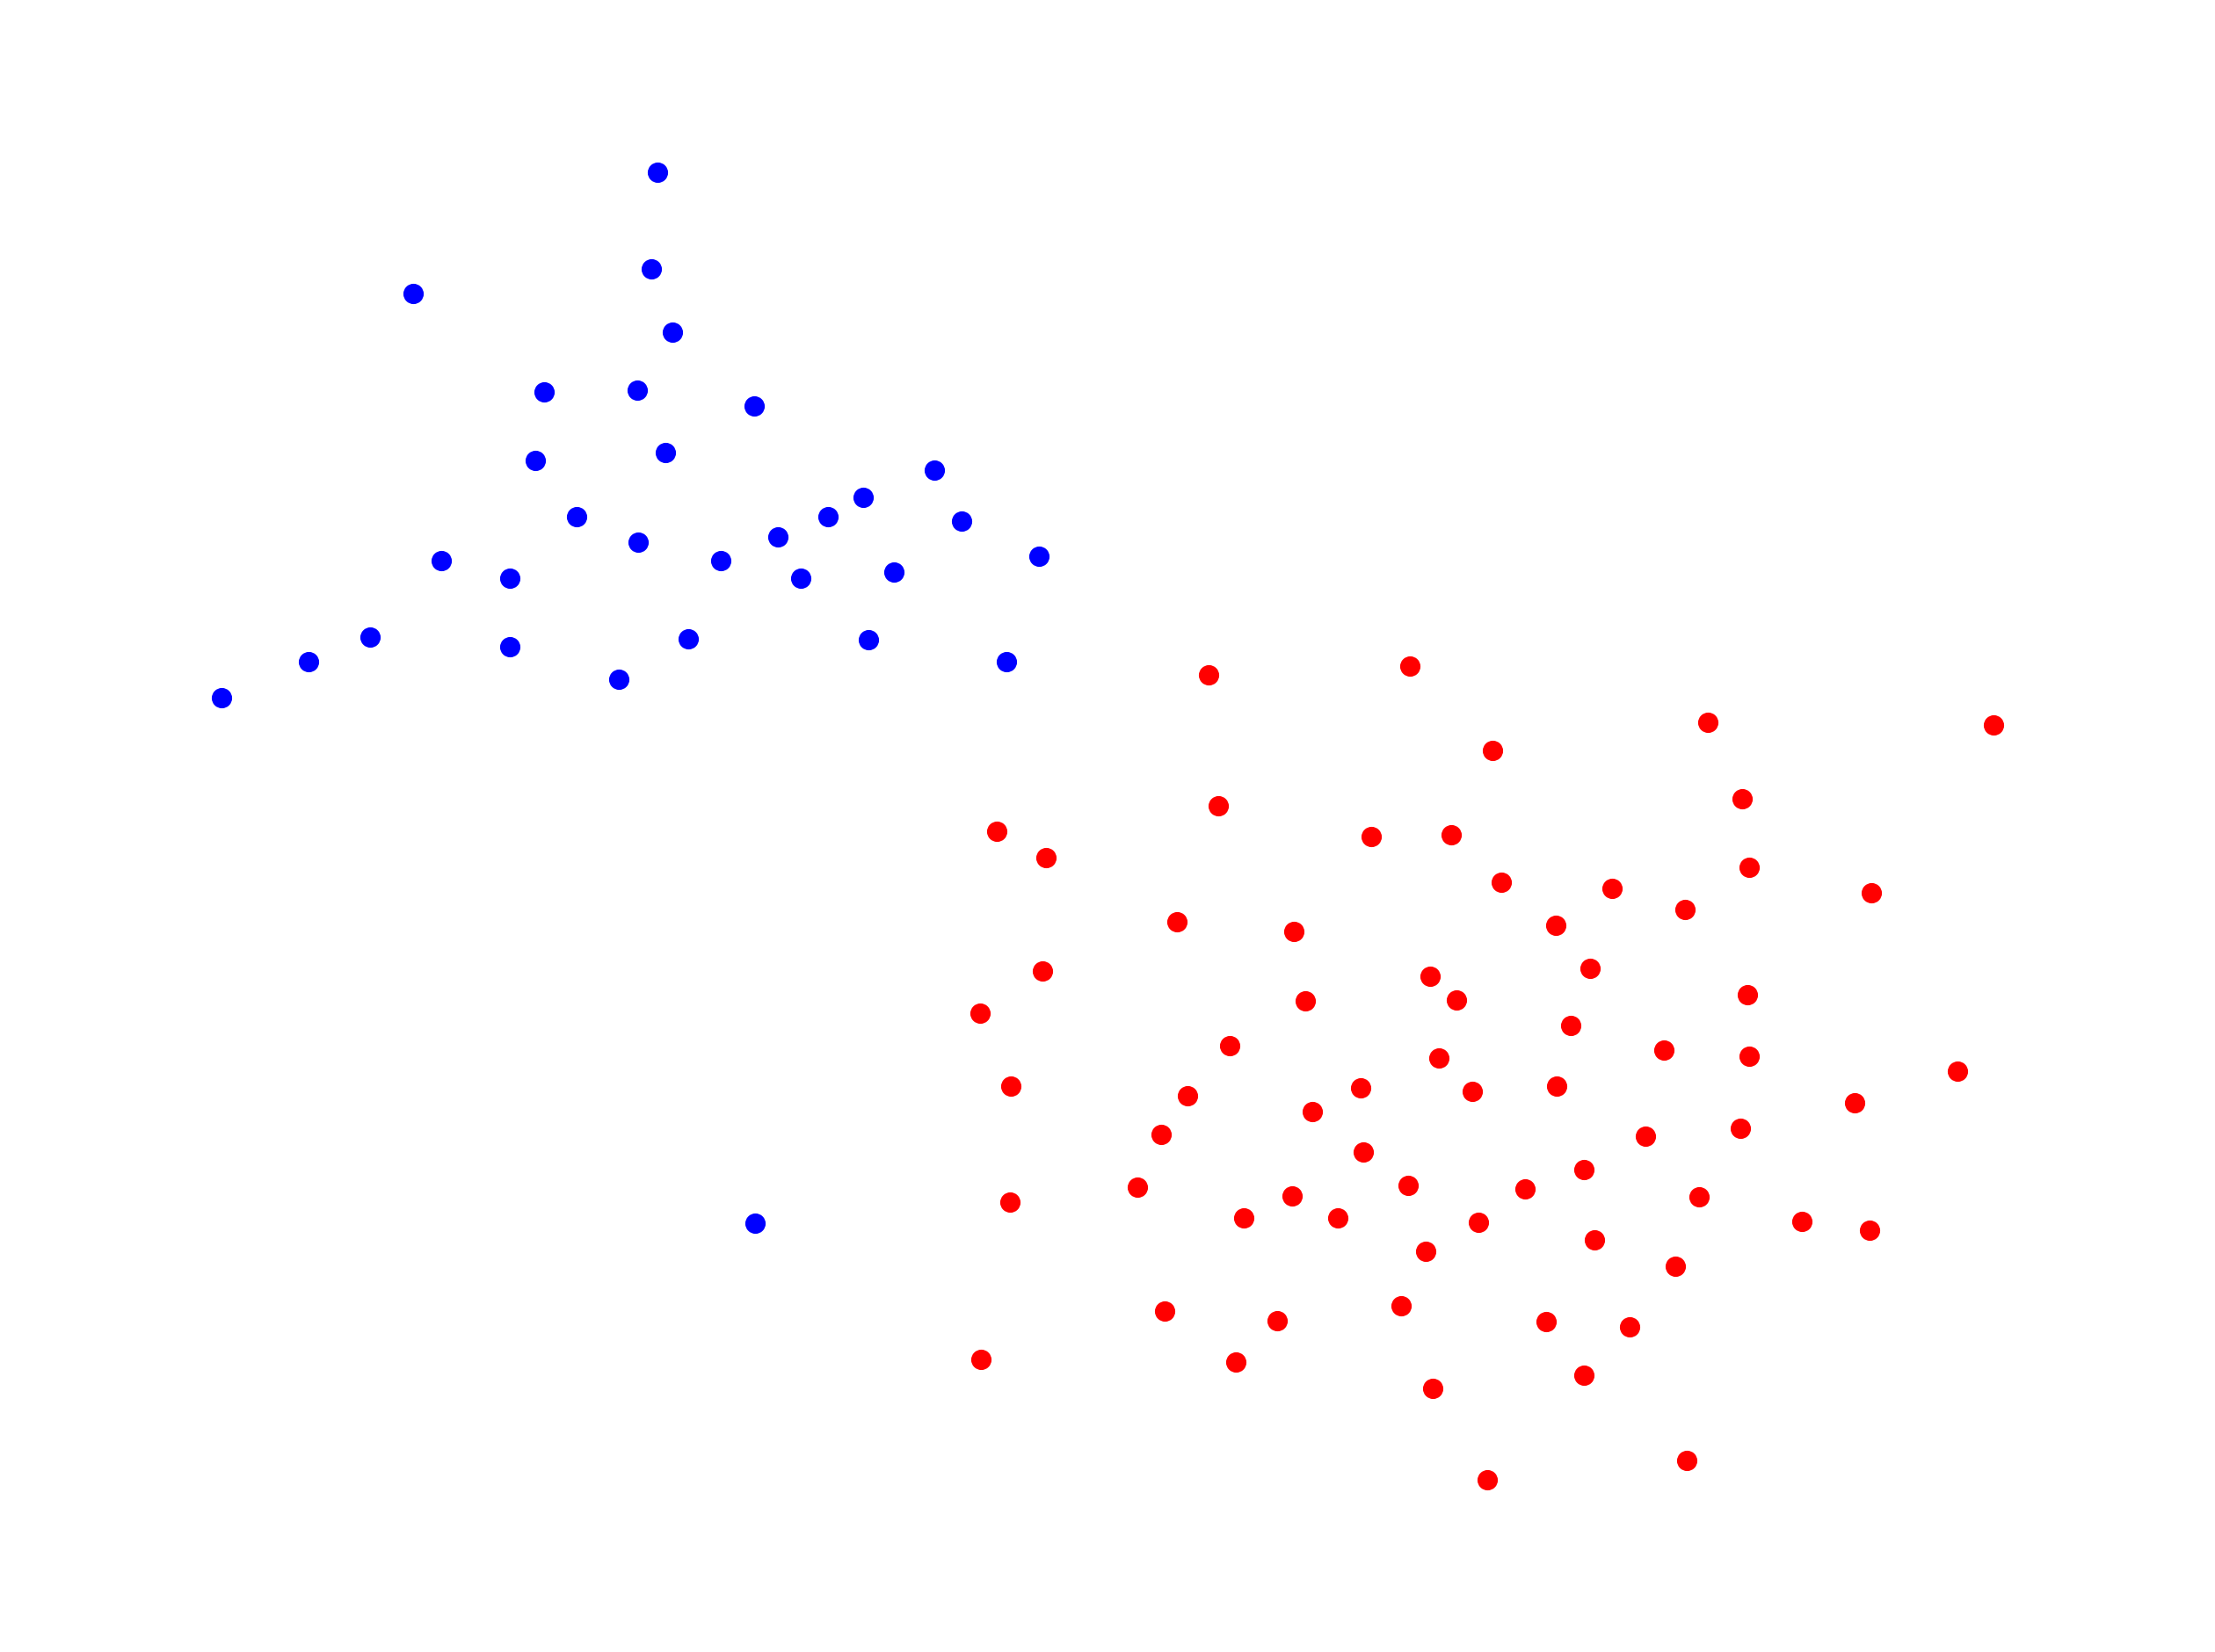


Weighted Stochastic Block Model
INDY
$$Z∈{\left\{0, 1\right\}}^{n}$$
$$Z_{i}\overset{iid}{∼}Cat(π_{0},π_{1})$$
Notes:
Just briefly, across all the project graphs being considered are undirected simple and weighted

Slide 10
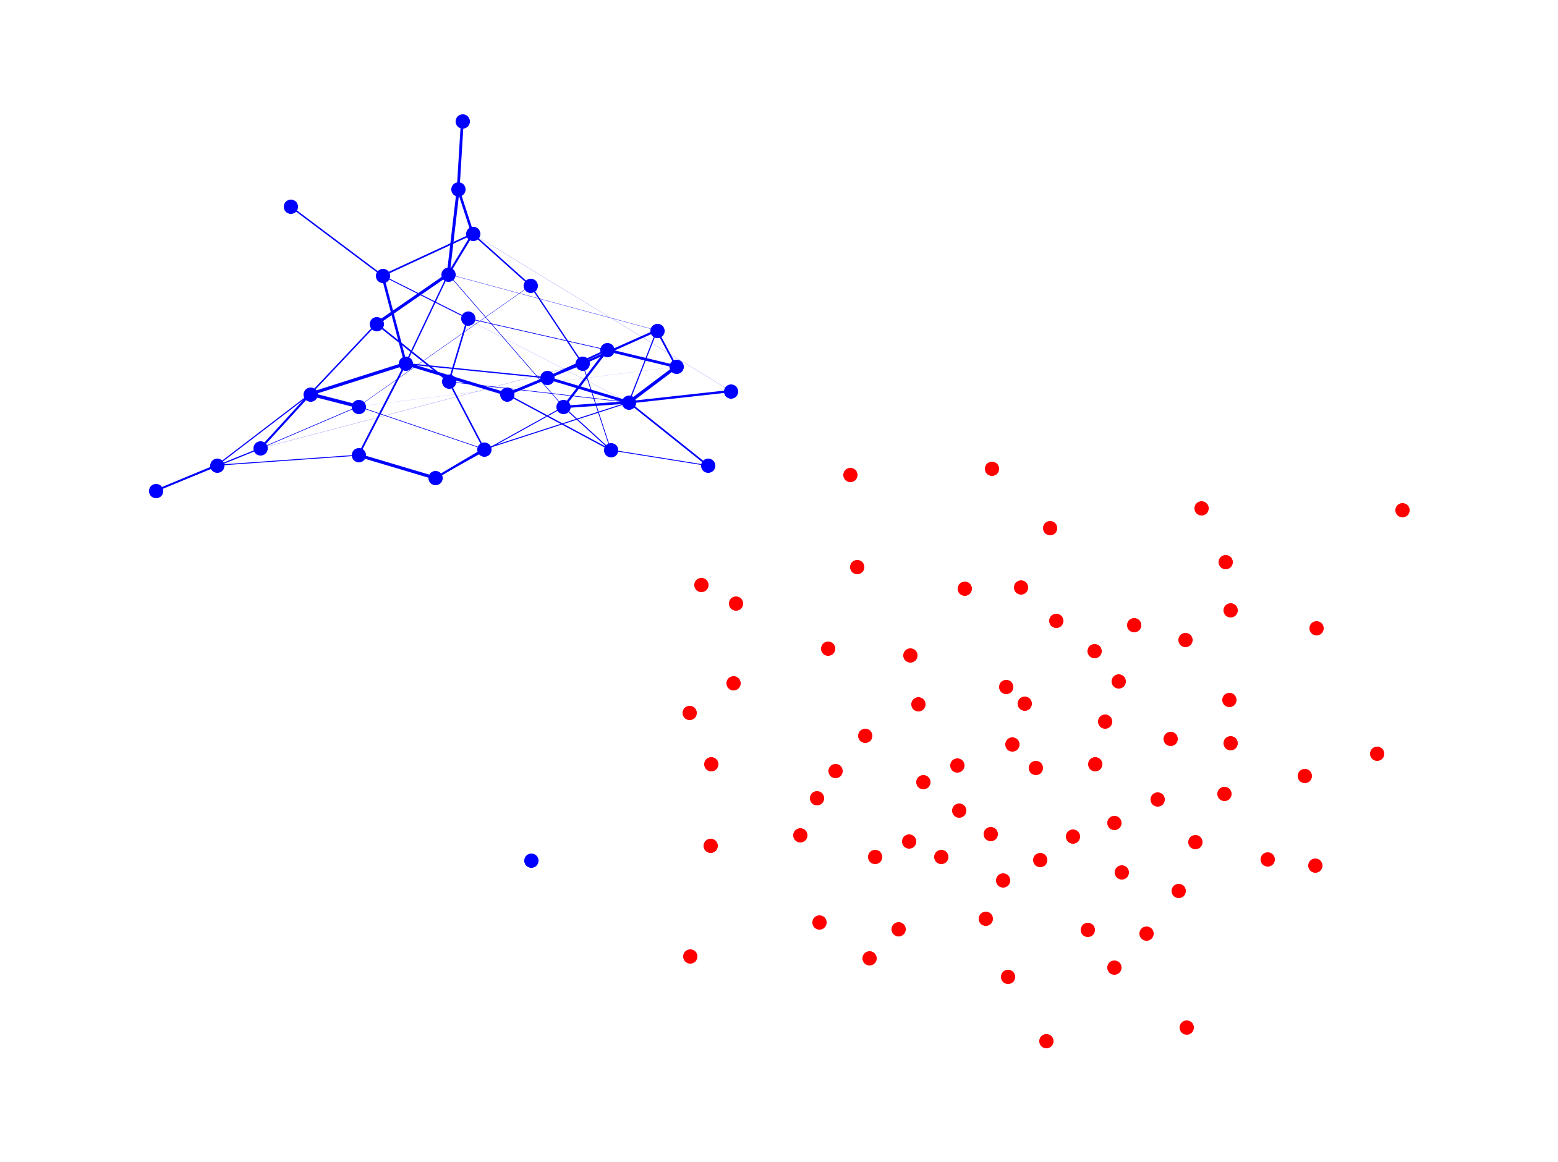


Weighted Stochastic Block Model
$$A_{ij}∣Z_{i}=0,Z_{j}=0\overset{ind}{∼}D\left(θ_{0,0}\right)$$
$$Θ=\left(\begin{matrix}θ_{0,0} & θ_{0,0} \\ θ_{0,0} & θ_{0,0}\end{matrix}\right)$$
INDY
Notes:
Just briefly, across all the project graphs being considered are undirected simple and weighted

Slide 11
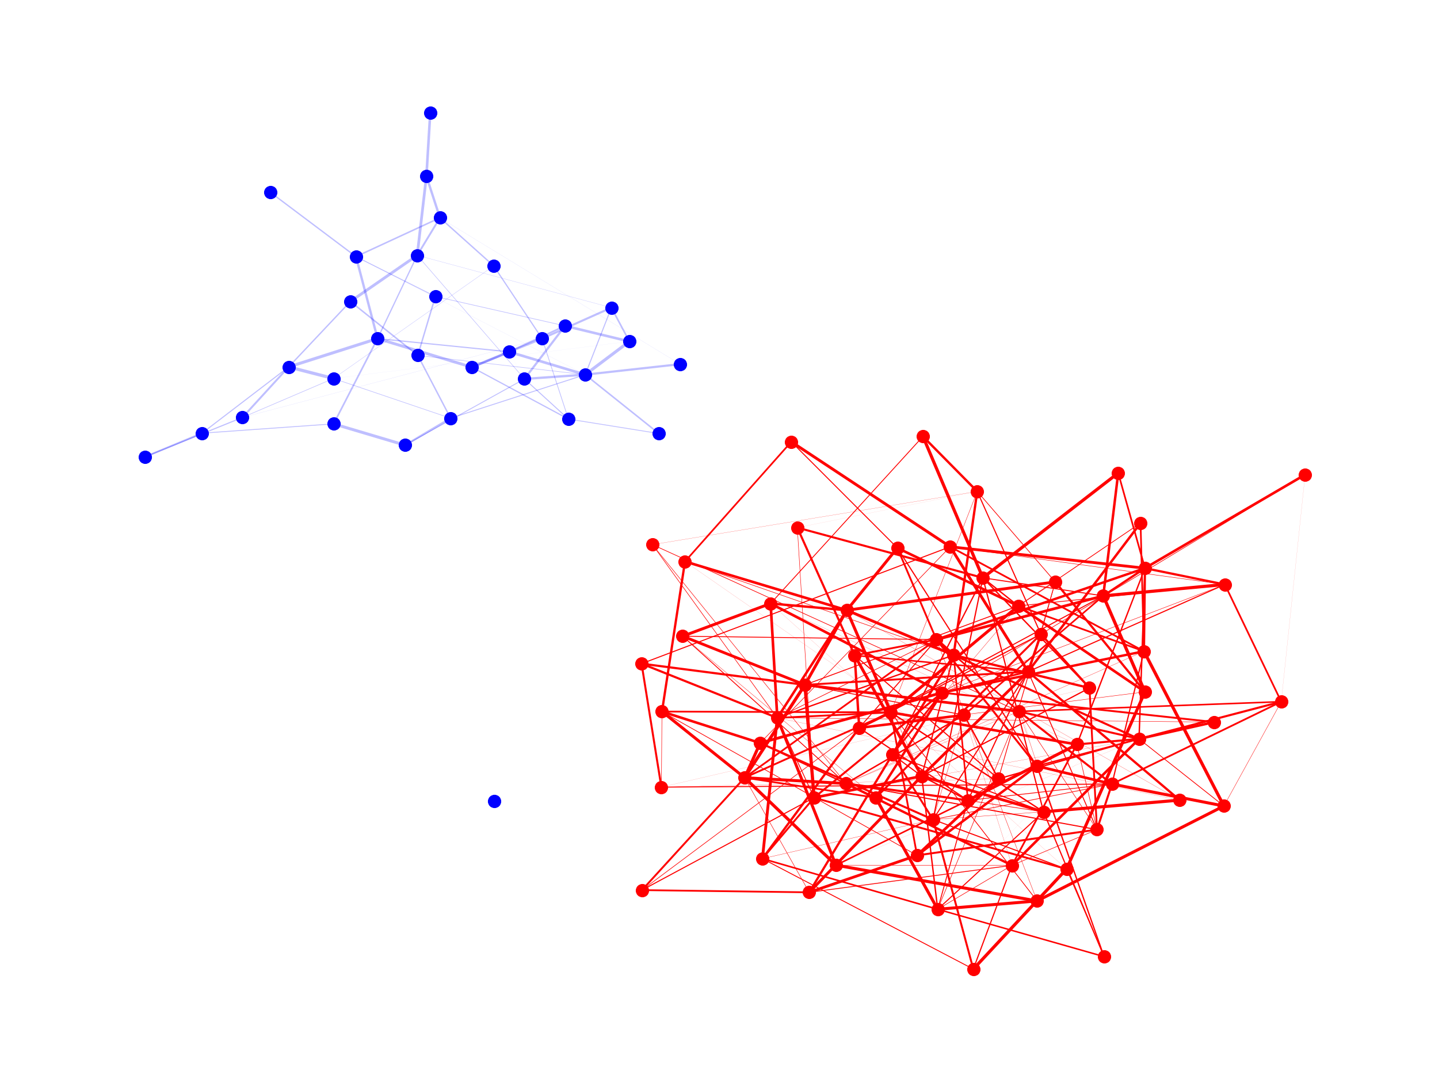


Weighted Stochastic Block Model
$$A_{ij}∣Z_{i}=1,Z_{j}=1\overset{ind}{∼}D\left(θ_{1,1}\right)$$
$$Θ=\left(\begin{matrix}θ_{0,0} & θ_{0,0} \\ θ_{0,0} & θ_{1,1}\end{matrix}\right)$$
INDY
Notes:
Just briefly, across all the project graphs being considered are undirected simple and weighted

Slide 12
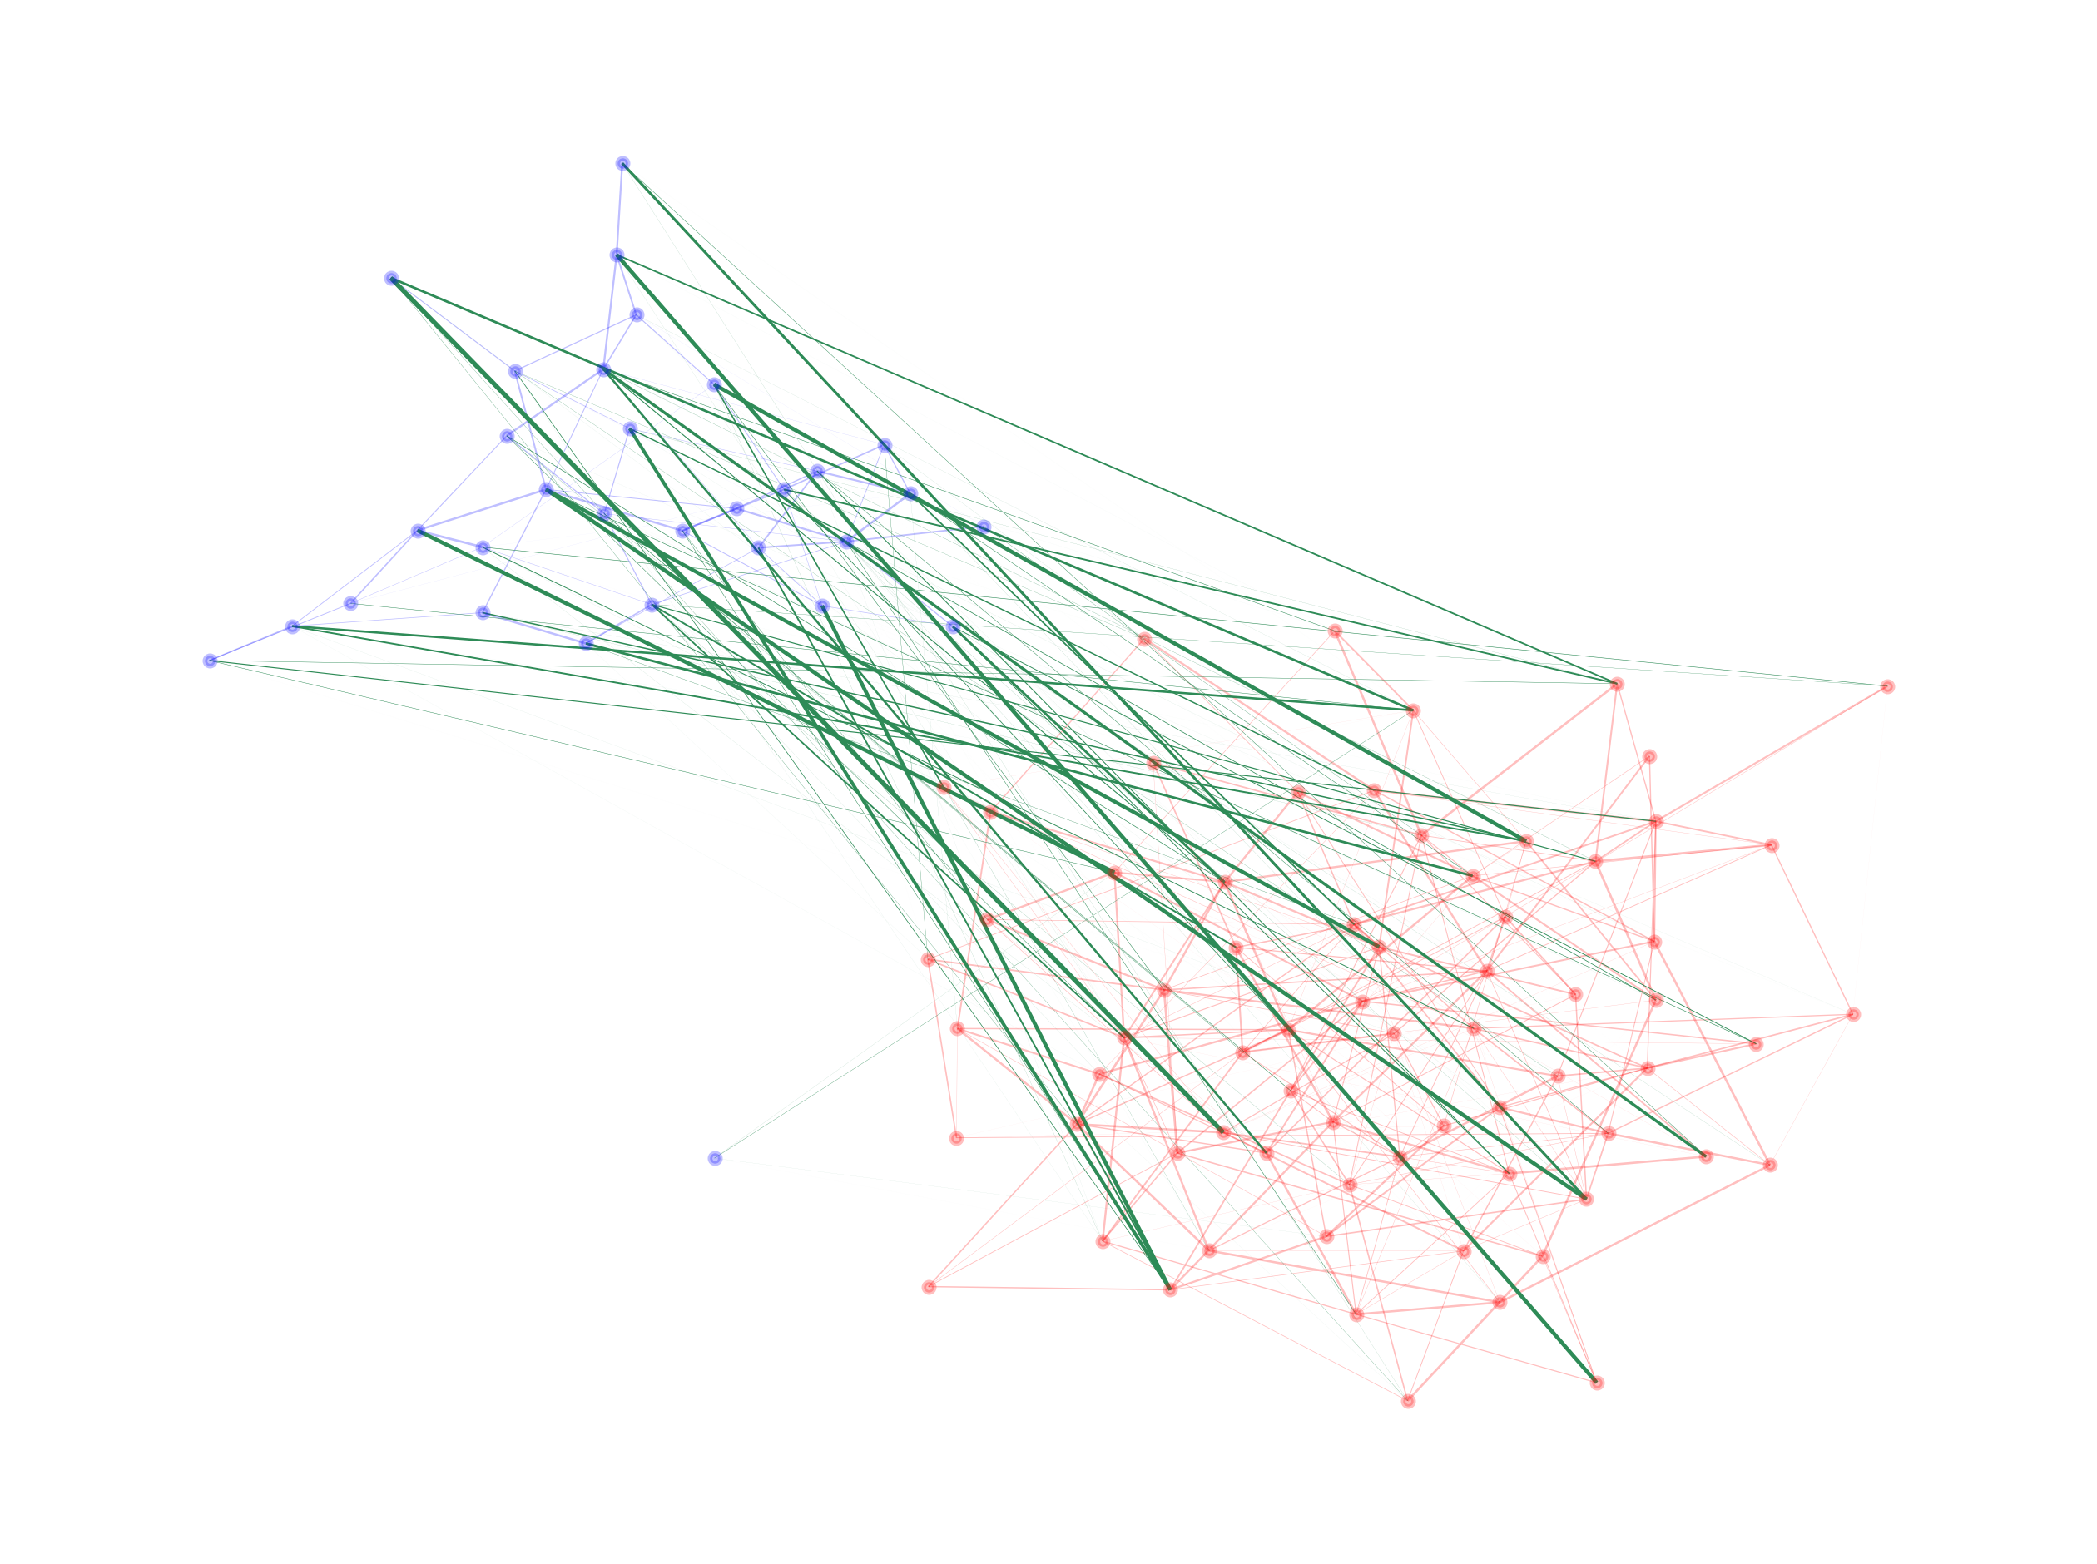


Weighted Stochastic Block Model
$$A_{ij}∣Z_{i}=0, Z_{j}=1\overset{ind}{∼}D\left(θ_{0,1}\right)$$
$$Θ=\left(\begin{matrix}θ_{0,0} & θ_{0,1} \\ θ_{1,0} & θ_{1,1}\end{matrix}\right)$$
INDY
Notes:
Just briefly, across all the project graphs being considered are undirected simple and weighted

Slide 13
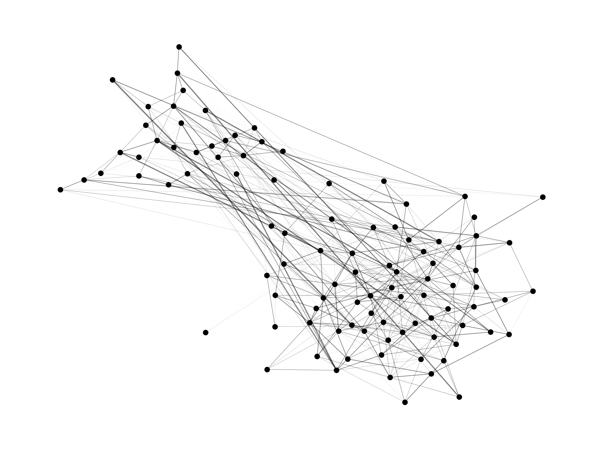
Weighted Stochastic Block Model
INDY
Notes:
Just briefly, across all the project graphs being considered are undirected simple and weighted

Slide 14

When only $A$ is observed, how can we recover the labelling $Z$?
INDY
Notes:
Just briefly, across all the project graphs being considered are undirected simple and weighted

Slide 15
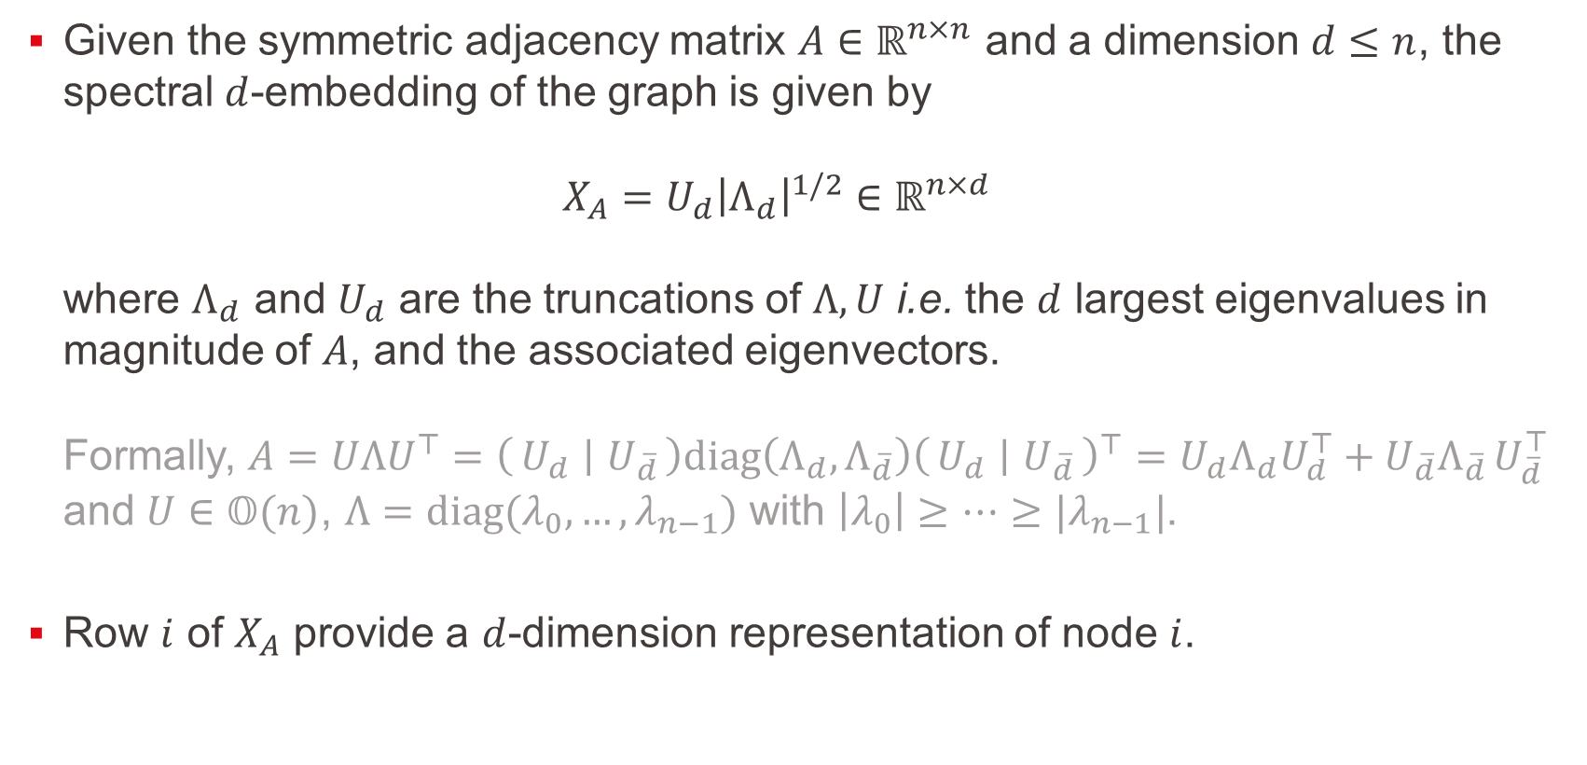
Spectral Embedding
Given the symmetric adjacency matrix $A∈ℝ^{n×n}$ and a dimension $d≤n$, the spectral $d$-embedding of the graph is given by $X_{A}=U_{d}{\left|Λ_{d}\right|}^{1/2}∈ℝ^{n×d}$ where $Λ_{d}$ and $U_{d}$ are the truncations of $Λ,U$ i.e. the $d$ largest eigenvalues in magnitude of $A$, and the associated eigenvectors. Formally, $A=UΛU^{⊤}=\left(U_{d} ∣ U_{\overline{d}}\right)diag\left(Λ_{d},Λ_{\overline{d}}\right){\left(U_{d} ∣ U_{\overline{d}}\right)}^{⊤}=U_{d}Λ_{d}U_{d}^{⊤}+U_{\overline{d}}Λ_{\overline{d} }U_{\overline{d}}^{⊤}$ and $U∈𝕆(n)$, $Λ=diag(λ_{0}, …, λ_{n−1})$ with $\left|λ_{0}\right|≥…≥|λ_{n−1}|$.
Row $i$ of $X_{A}$ provide a $d$-dimension representation of node $i$.
INDY
Notes:
Just briefly, across all the project graphs being considered are undirected simple and weighted

Slide 16
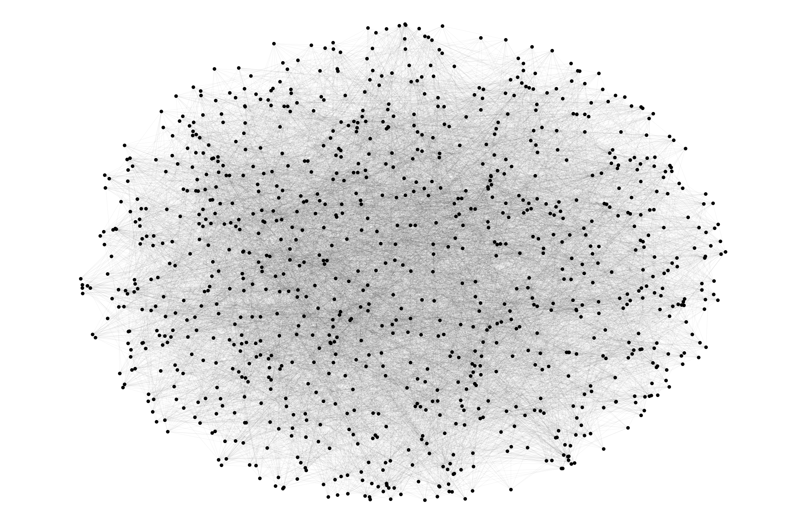

Spectral Embedding
$$A∈ℝ^{n×n}$$
INDY
Notes:
Just briefly, across all the project graphs being considered are undirected simple and weighted

Slide 17
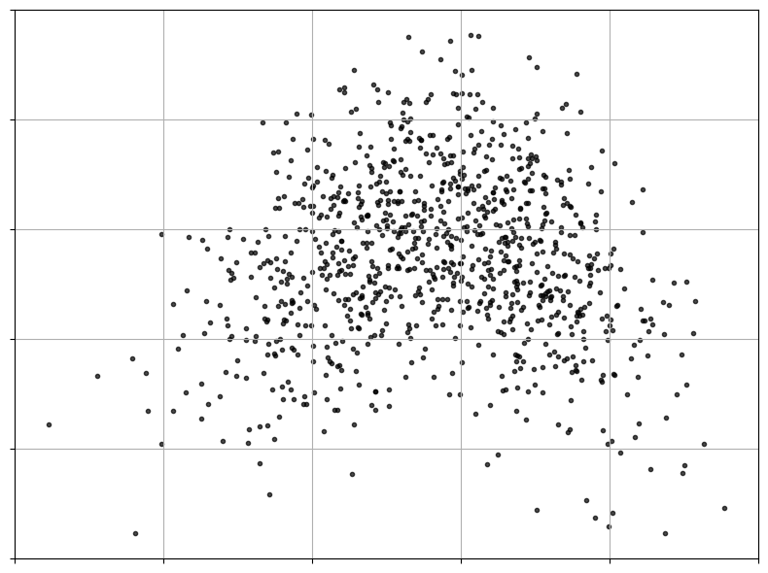


Spectral Embedding
$$X_{A}∈ℝ^{n×d}$$
INDY
$$ℝ^{d=2}$$
Notes:
Just briefly, across all the project graphs being considered are undirected simple and weighted

Slide 18
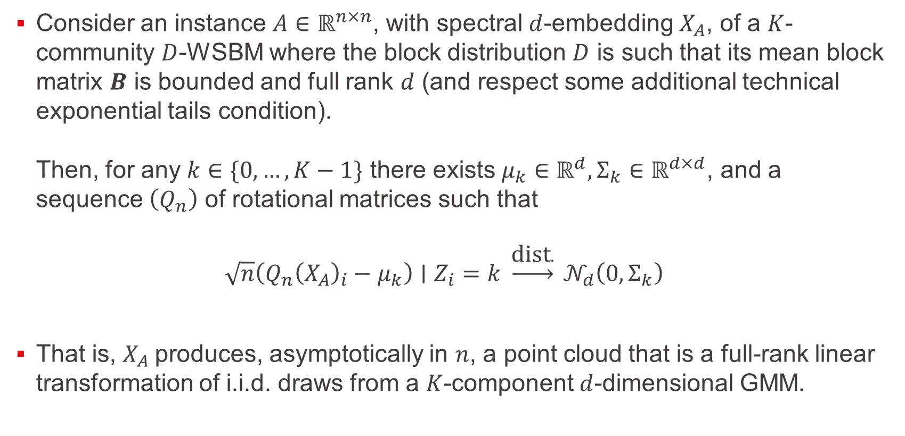
Central Limit Theorem – Corollary
Consider an instance $A∈ℝ^{n×n}$, with spectral $d$-embedding $X_{A}$, of a $K$-community $D$-WSBM where the block distribution $D$ is such that its mean block matrix $B$ is bounded and full rank $d$ (and respect some additional technical exponential tails condition). Then, for any $k∈\{0, …, K−1\}$ there exists $μ_{k}∈ℝ^{d}, Σ_{k}∈ℝ^{d×d}$, and a sequence $\left(Q_{n}\right)$ of rotational matrices such that $\sqrt{n}\left(Q_{n}{\left(X_{A}\right)}_{i}−μ_{k}\right)∣Z_{i}=k \underset{→}{\text{dist}.} 𝒩_{d}\left(0,Σ_{k}\right)$
That is, $X_{A}$produces, asymptotically in $n$, a point cloud that is a full-rank linear transformation of i.i.d. draws from a $K$-component $d$-dimensional GMM.
INDY
Notes:
Just briefly, across all the project graphs being considered are undirected simple and weighted

Slide 19
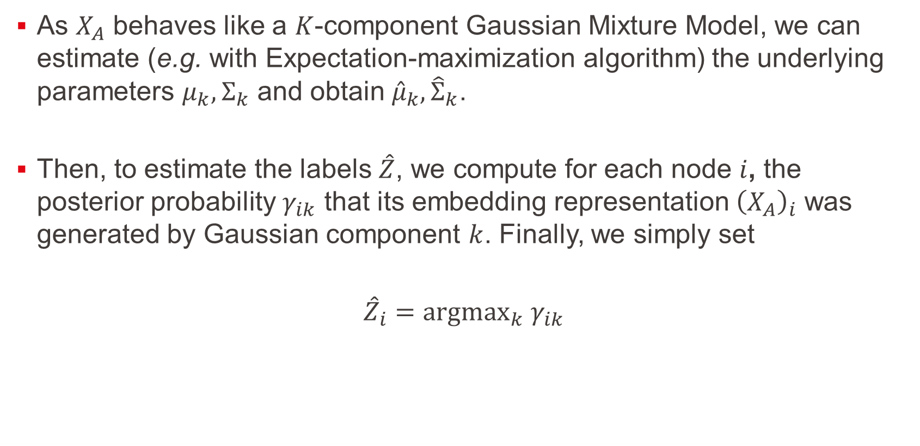
Spectral Clustering – GMM fitting
As $X_{A}$ behaves like a $K$-component Gaussian Mixture Model, we can estimate (e.g. with Expectation-maximization algorithm) the underlying parameters $μ_{k},Σ_{k}$ and obtain ${\hat{μ}}_{k},{\hat{Σ}}_{k}$.
Then, to estimate the labels $\hat{Z}$, we compute for each node $i$, the posterior probability $γ_{ik}$ that its embedding representation ${\left(X_{A}\right)}_{i}$ was generated by Gaussian component $k$. Finally, we simply set
$${\hat{Z}}_{i}={argmax}_{k} γ_{ik}$$
INDY
Notes:
Just briefly, across all the project graphs being considered are undirected simple and weighted

Slide 20
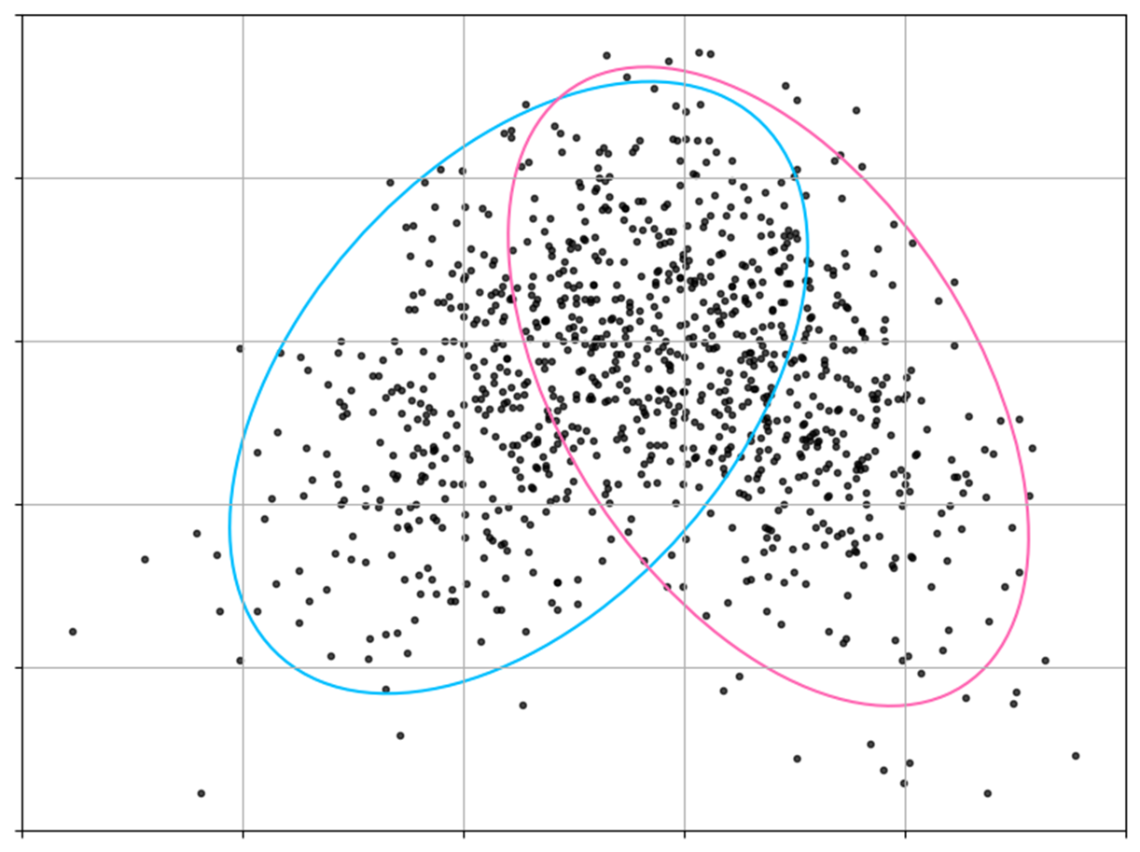
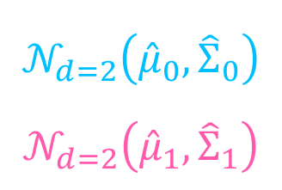
Spectral Clustering – GMM fitting
$$𝒩_{d=2}\left({\hat{μ}}_{0},{\hat{Σ}}_{0}\right)$$
$$𝒩_{d=2}\left({\hat{μ}}_{1},{\hat{Σ}}_{1}\right)$$
INDY
Notes:
Just briefly, across all the project graphs being considered are undirected simple and weighted

Slide 21
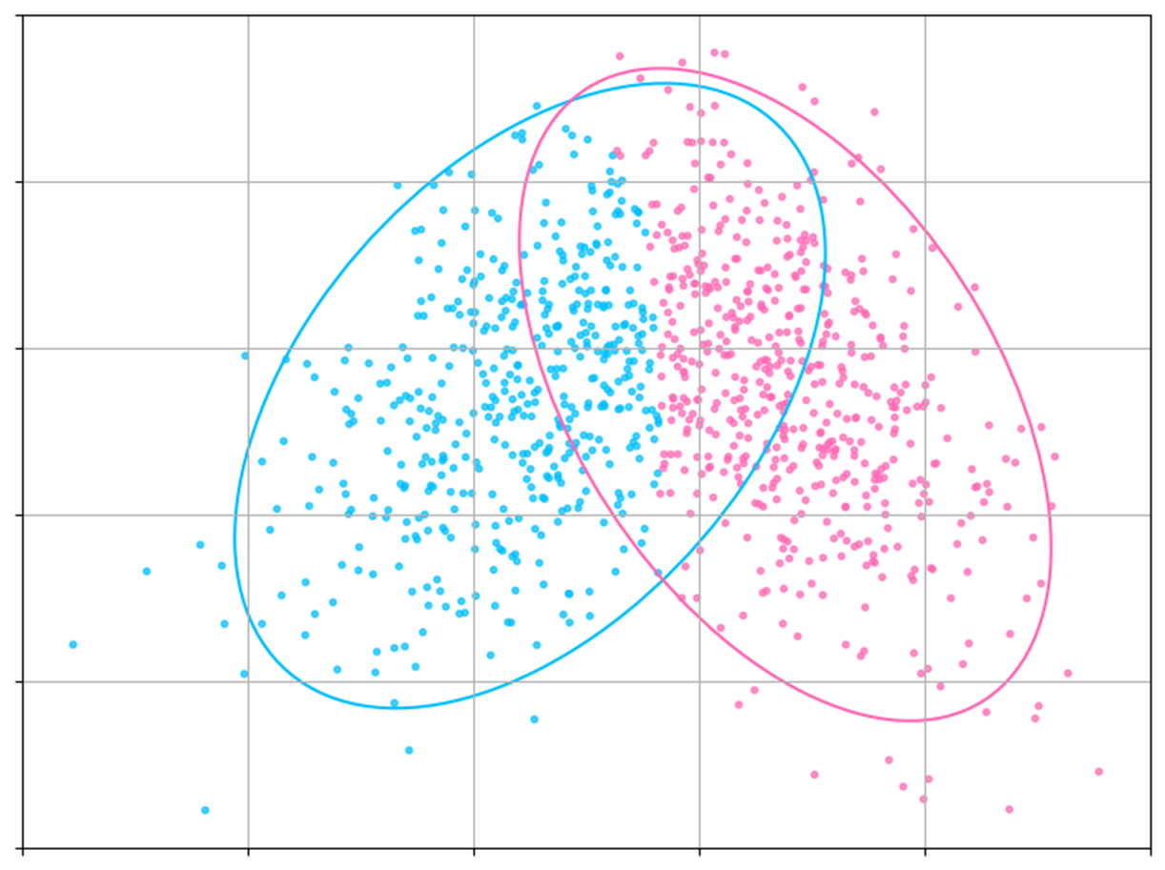
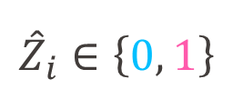
Spectral Clustering – GMM fitting
$${\hat{Z}}_{i}∈\left\{0, 1\right\}$$
INDY
Notes:
Just briefly, across all the project graphs being considered are undirected simple and weighted

Slide 22
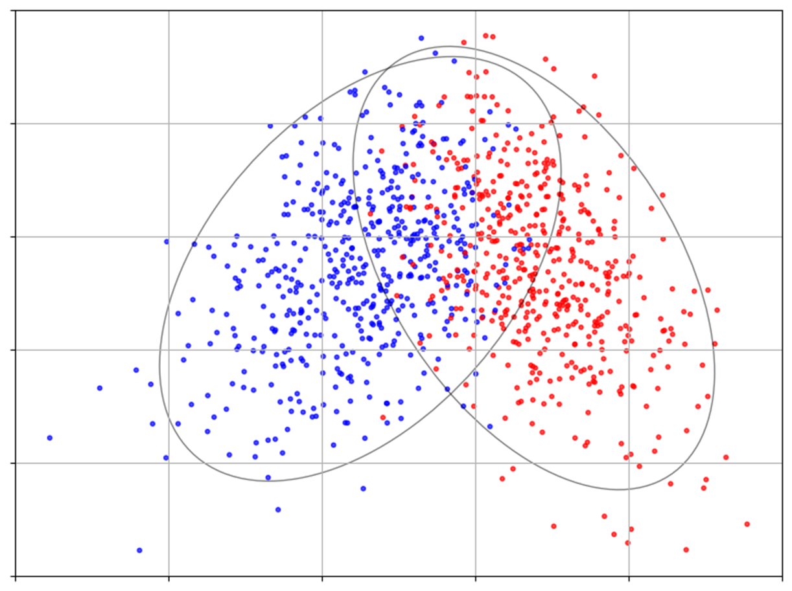
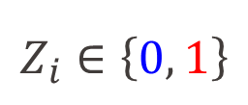
Spectral Clustering – GMM fitting
$$Z_{i}∈\left\{0, 1\right\}$$
INDY
Notes:
Just briefly, across all the project graphs being considered are undirected simple and weighted

Slide 23
Obviously, it doesn’t always work.
INDY
Notes:
Just briefly, across all the project graphs being considered are undirected simple and weighted

Slide 24
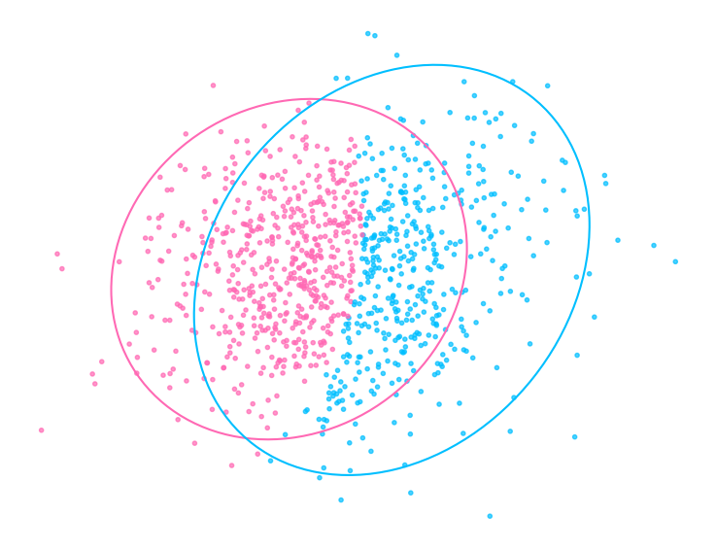
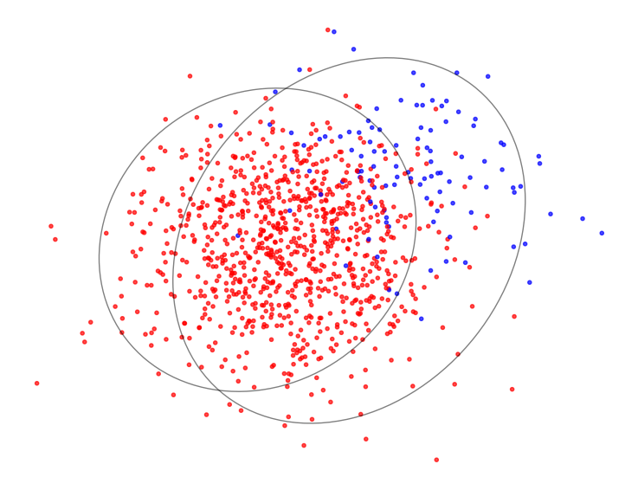


Spectral Clustering – GMM fitting
$$\hat{Z}$$
$$Z$$
INDY
Poor community separation and hence poor classification accuracy
Notes:
Just briefly, across all the project graphs being considered are undirected simple and weighted

Slide 25
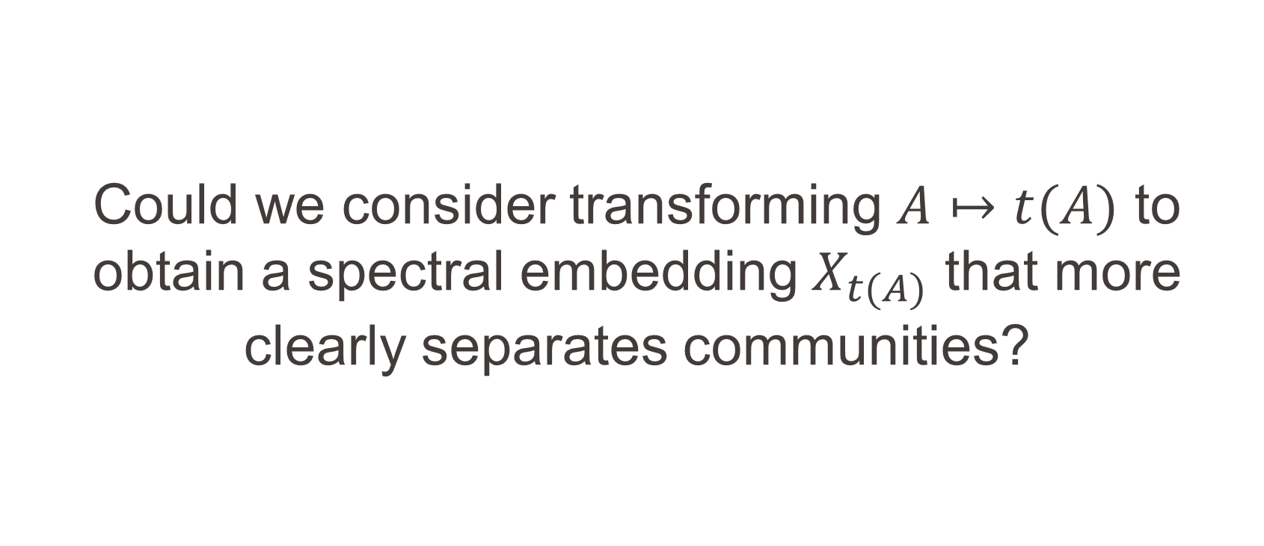
Could we consider transforming $A↦t(A)$ to obtain a spectral embedding $X_{t(A)}$ that more clearly separates communities?
INDY
Notes:
Just briefly, across all the project graphs being considered are undirected simple and weighted

Slide 26
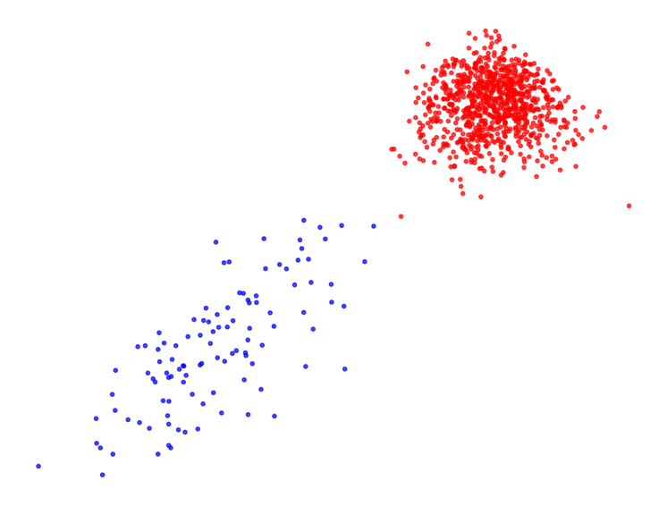
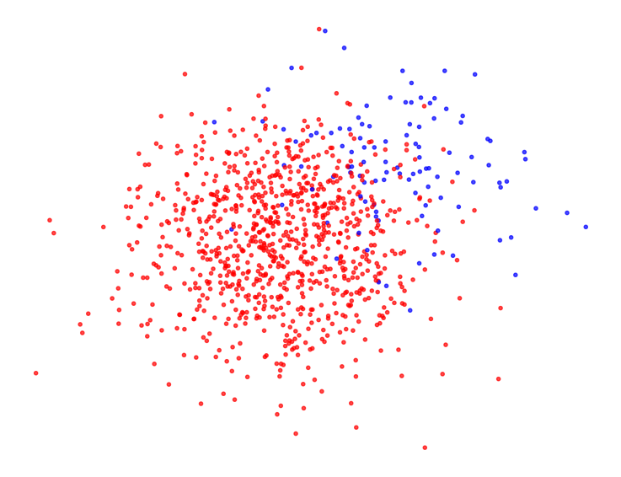
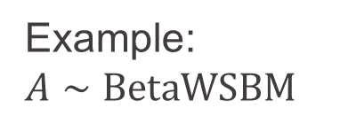




Weight Transformation
Example: $A∼BetaWSBM$
$$X_{t(A)}$$
$t \text{: }A ↦\text{𝟙}(A≤τ)$
$$X_{A}$$
INDY
Here applying $t$ led to a better community separation!
Notes:
Just briefly, across all the project graphs being considered are undirected simple and weighted

Slide 27
How can we measure community separation?
INDY
Notes:
Just briefly, across all the project graphs being considered are undirected simple and weighted

Slide 28
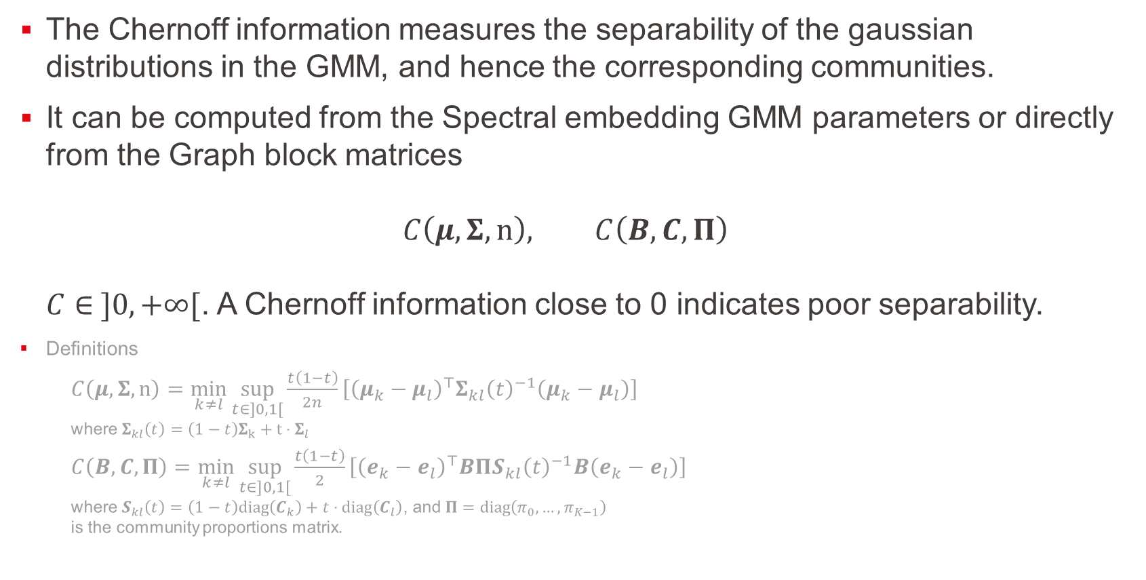
Separability measure – Chernoff Information
The Chernoff information measures the separability of the gaussian distributions in the GMM, and hence the corresponding communities.
It can be computed from the Spectral embedding GMM parameters or directly from the Graph block matrices $C\left(μ,Σ,n\right), C\left(B,C,Π\right)$ $C∈ ]0,+∞[$. A Chernoff information close to 0 indicates poor separability.
Definitions
$C\left(μ,Σ,n\right)=\min_{k≠l}{\sup_{t∈]0,1[}{\frac{t\left(1−t\right)}{2n}\left[{\left(μ_{k}−μ_{l}\right)}^{⊤}Σ_{kl}{\left(t\right)}^{−1}\left(μ_{k}−μ_{l}\right)\right]}}$ where $Σ_{kl}\left(t\right)=\left(1−t\right)Σ_{k}+t⋅Σ_{l}$
$C\left(B,C,Π\right)=\min_{k≠l}{\sup_{t∈]0,1[}{\frac{t\left(1−t\right)}{2}\left[{\left(e_{k}−e_{l}\right)}^{⊤}BΠS_{kl}{\left(t\right)}^{−1}B\left(e_{k}−e_{l}\right)\right]}}$ where $S_{kl}\left(t\right)=\left(1−t\right)diag\left(C_{k}\right)+t⋅diag\left(C_{l}\right)$, and $Π=diag\left(π_{0},…,π_{K−1}\right)$ is the community proportions matrix.
INDY
Notes:
Just briefly, across all the project graphs being considered are undirected simple and weighted

Slide 29
Experimentation
INDY
Notes:
Just briefly, across all the project graphs being considered are undirected simple and weighted

Slide 30
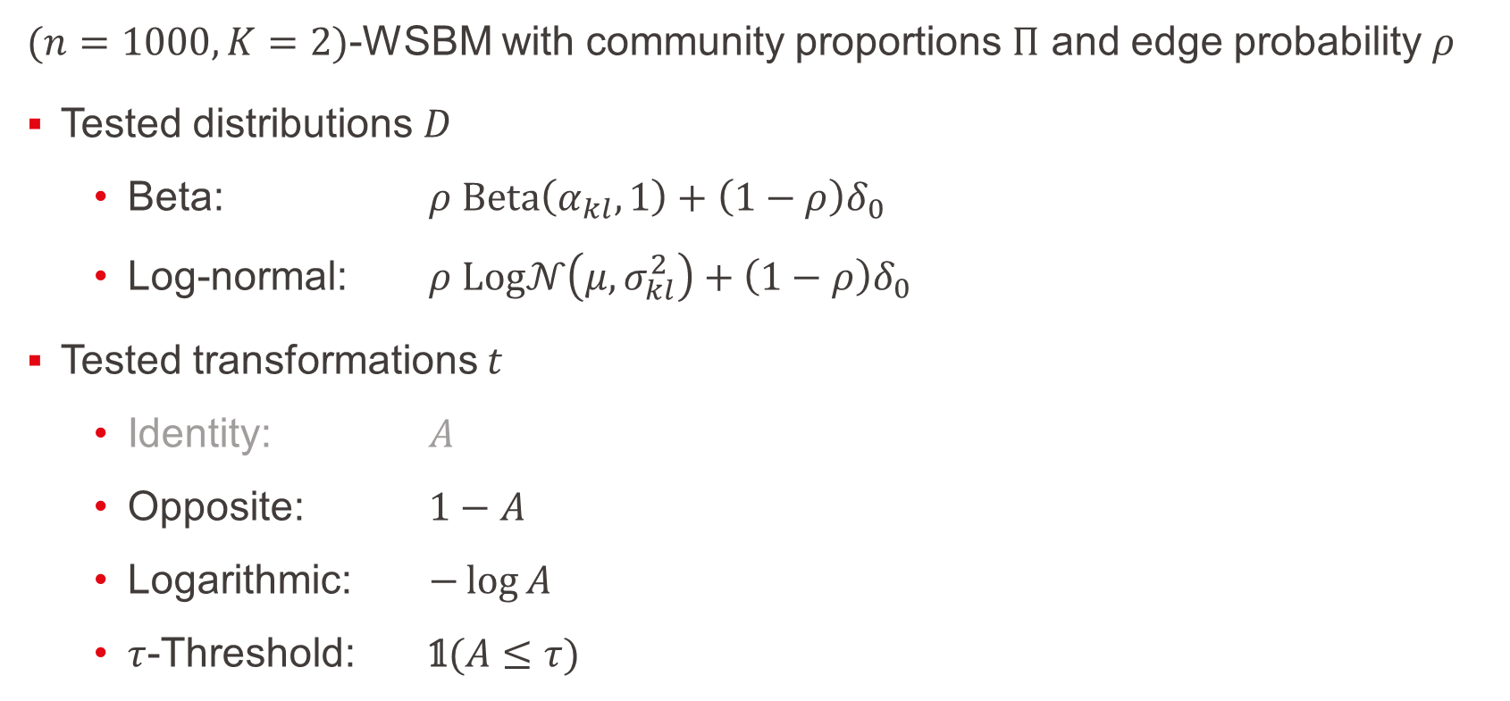
Experimental Setup
$(n=1000, K=2)$-WSBM with community proportions $Π$ and edge probability $ρ$
Tested distributions $D$
Beta: $ρ Beta\left(α_{kl},1\right)+\left(1−ρ\right)δ_{0}$
Log-normal: $ρ Log𝒩\left(μ,σ_{kl}^{2}\right)+\left(1−ρ\right)δ_{0}$
Tested transformations $t$
Identity: $A$
Opposite: $1−A$
Logarithmic: $−\log{A}$
$τ$-Threshold: $\text{𝟙}(A≤τ)$
INDY
Notes:
Just briefly, across all the project graphs being considered are undirected simple and weighted

Slide 31
Results
TODO
T
INDY
Notes:
Just briefly, across all the project graphs being considered are undirected simple and weighted

Slide 32
Preliminary observations
TODO
Threshold and Log seem to perform well generally
It’s rare to have competing Chernoffs informations btwn models – either e.g. Threshold dominates, or Identity
Chosen transformations can’t overcome intrinsic hardness of clustering some graphs (when model parameters (rho, distribution) are chosen to be challenging)
INDY
Notes:
Just briefly, across all the project graphs being considered are undirected simple and weighted

Slide 33
What’s next?
INDY
Notes:
Just briefly, across all the project graphs being considered are undirected simple and weighted

Slide 34
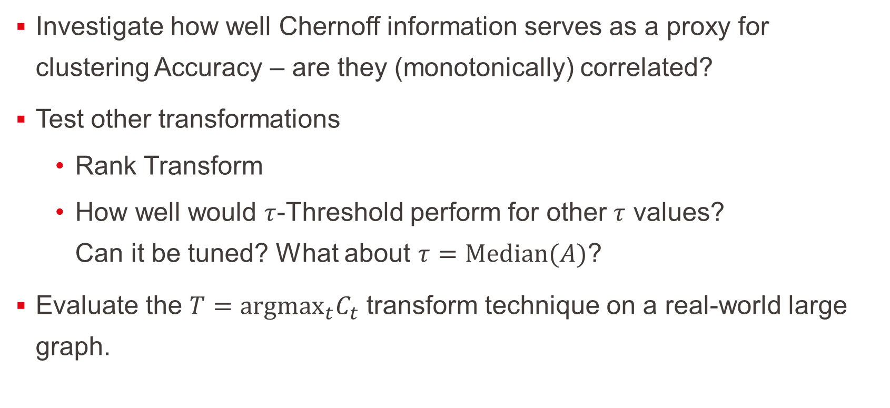
What’s next?
Investigate how well Chernoff information serves as a proxy for clustering Accuracy – are they (monotonically) correlated?
Test other transformations
Rank Transform
How well would $τ$-Threshold perform for other $τ$ values? Can it be tuned? What about $τ=Median(A)$?
Evaluate the $T={argmax}_{t}C_{t}$ transform technique on a real-world large graph.
INDY
Notes:
Just briefly, across all the project graphs being considered are undirected simple and weighted

Slide 35
References
Ian Gallagher, Andrew Jones, Anna Bertiger, Carey E. Priebe & Patrick Rubin-Delanchy (2024) Spectral Embedding of Weighted Graphs, Journal of the American Statistical Association, 119:547, 1923-1932, DOI: 10.1080/01621459.2023.2225239
Joshua Cape, Xianshi Yu, & Jonquil Z. Liao (2024). Robust spectral clustering with rank statistics. arXiv preprint arXiv:2408.10136. https://doi.org/10.48550/arXiv.2408.10136
INDY
Notes:
Just briefly, across all the project graphs being considered are undirected simple and weighted

Slide 36
Thank you!
INDY
Notes:
Just briefly, across all the project graphs being considered are undirected simple and weighted

